Slide 1
Nordic Transmission Grid Model based on open sources
Internship
Niek Brekelmans

Slide 2
Overview
Introduction
Open-source models, tools and datasets
Model
Validation data
Load flow
Conclusion
Further work

Slide 3
Overview
Introduction
Open-source models, tools and datasets
Model
Validation data
Load flow
Conclusion
Further work

Slide 4
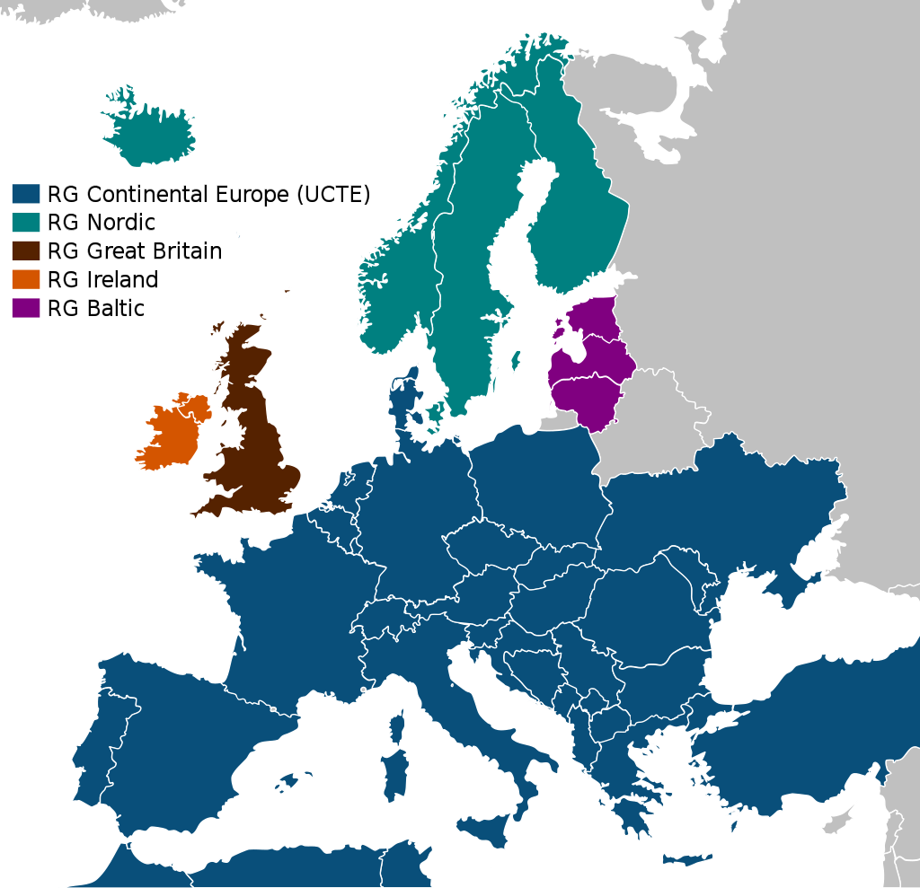
Introduction
Three-month internship
Nordic synchronous grid in PSS/E
Sweden, Norway, Finland and eastern Denmark
220 kV and above
Static model
Single timestamp: 2020-03-04 19:00
Reproducible
Updatable
Reliable
Extendable
Source: Wikipedia (Synchronous grid of Continental Europe)

Slide 5
Overview
Introduction
Open-source models, tools and datasets
Model
Validation data
Load flow
Conclusion
Further work

Slide 6
Open-source data and tools
Advantages
Disadvantages / challenges
Availability
Transparency
Community
Encouraging innovation
Missing information
Incomplete datasets
Hard to combine
Unknown metadata

Slide 7


OpenStreetMap
Open-source map
Geographically accurate
Crowdsourcing
Peer reviewing
Downloadable
Available for power grids!

Slide 8
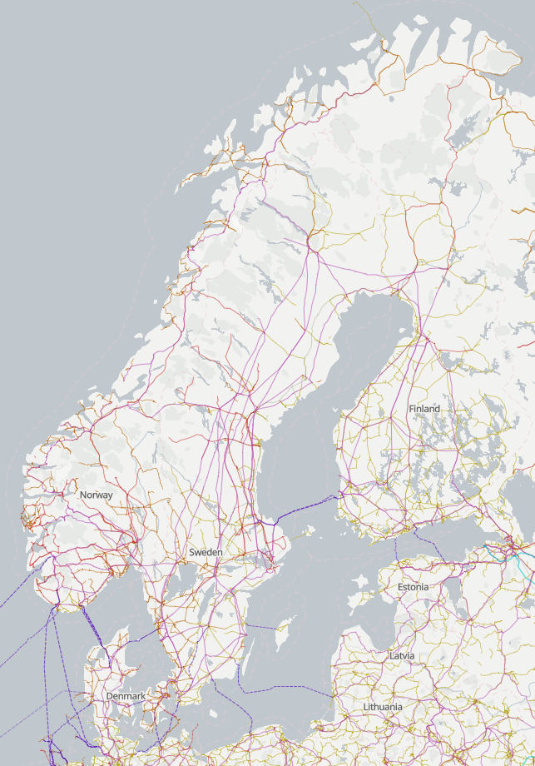
OSM for power
Available information
 | Nr. Lines | With voltage [%]
Denmark | 3,700 | 98.51%
Finland | 3,533 | 61.96%
Norway | 13,338 | 72.99%
Sweden | 832 | 77.16%
The Netherlands | 4,172 | 99.62%
Germany | 37,228 | 96.47%

Slide 9
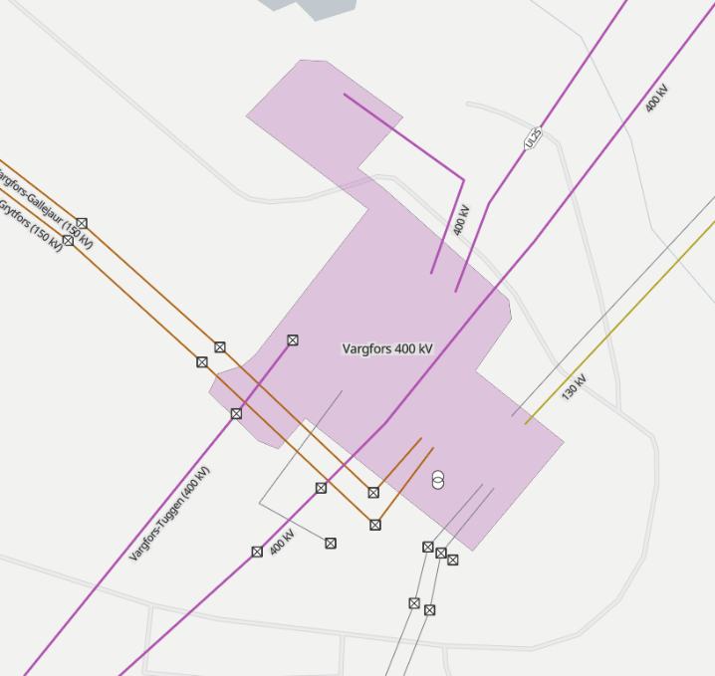
SciGRID
Limitations
Convert OSM data to model
Topology
Buses
Lines
Transformers
HVDC links
Relations
Relations
Missing information

Slide 10
GridKit (OSM)
Limitations
Convert OSM data to model with heuristics
‘Guess’ relations
Topology
Buses
Lines
Transformers
HVDC links
Possible wrong connections
Missing information

Slide 11
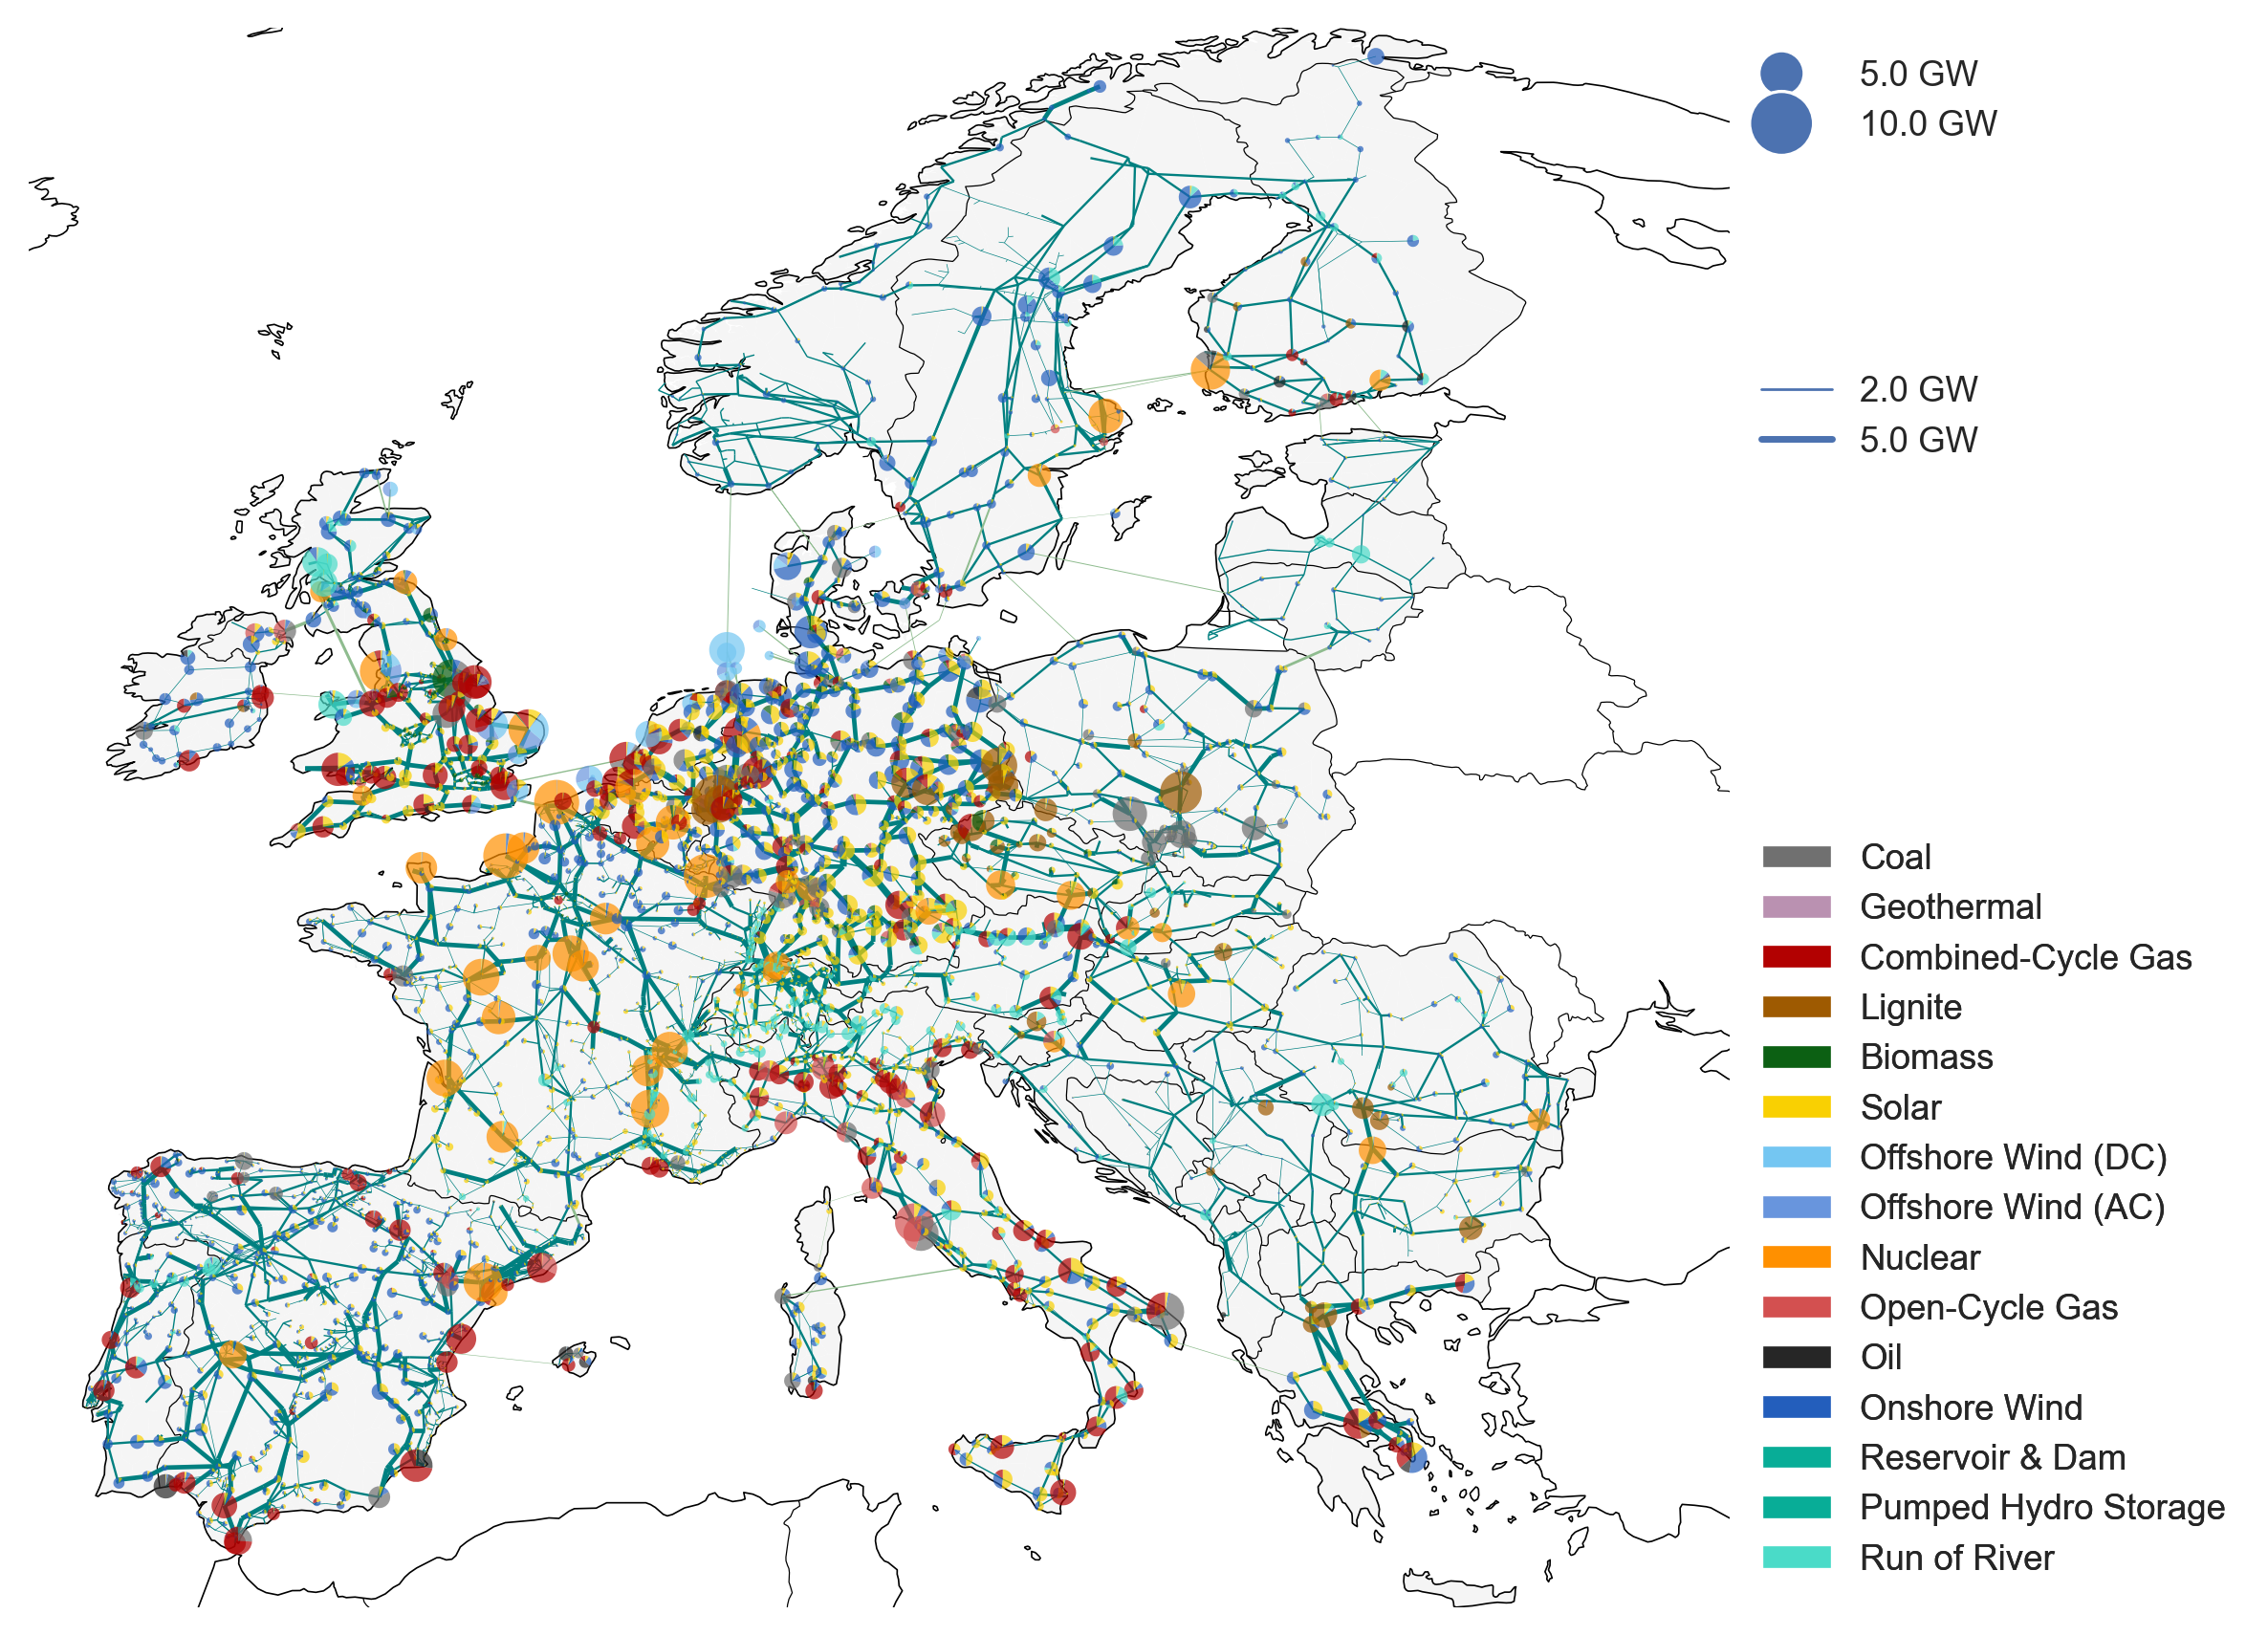
PyPSA-Eur
Python for PowerSystemAnalysis – Europe
Multiple tools combined to build full transmission network of Europe
Technische Universität Berlin
Active community
Clustering and aggregation not used
Adaptations
Source: PyPSA-Eur

Slide 12
PyPSA-Eur
GridKit (ENTSO‑E)
Buses Transformers
Lines HVDC Links
Open Power System Data (OPSD)
Load (time series)
Generation (renewable capacity)
Weather data
Renewable generation (time series)
Power Plant Matching
Generation (capacity)

Slide 13
GridKit (ENTSO-E) PyPSA-Eur
Limitations
Unofficial extract of ENTSO-E Transmission System Map
Topology
Buses
Lines
Transformers
HVDC links
Topological over geographical
Line parameters from standard types
Transformers derived
Capacity unknown
Voltage level (400 kV → 380 kV)
Reactive compensation missing

Slide 14
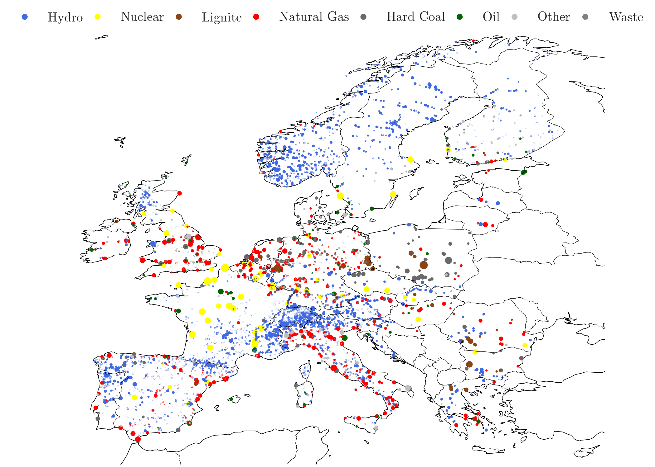
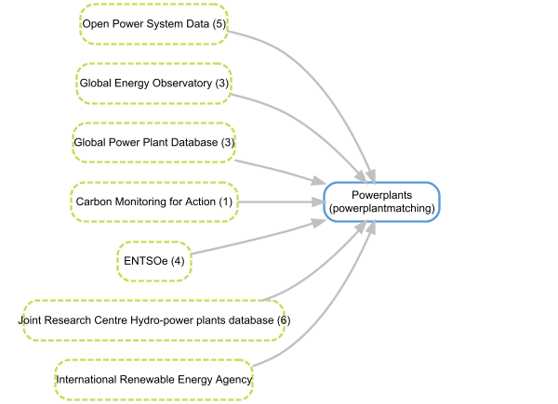
Power Plant Matching PyPSA-Eur
Limitations
Cleaning, standardizing and combining power plant data sources
Capacity
Type
Coordinates
Only global reliability score
Capacity change over years
Attached to closest LV bus
Source: powerplantmatching

Slide 15
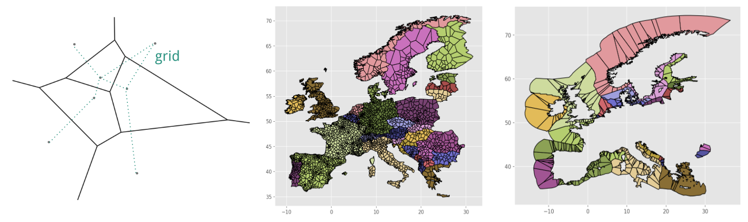
Open Power System Data (OPSD) PyPSA-Eur
Limitations
Load distribution is approximated
Data per country
Includes losses
Collect, check, process, document and publish data
Load
ENTSO-E Transparency Platform
Time series of load per country
Connect to buses in PyPSA-Eur:
Voronoi cells
Gross Domestic Product (60%)
Population (40%)
Source: PyPSA-Eur

Slide 16
Open Power System Data (OPSD)
Limitations
Collect, check, process, document and publish data
Generation (renewable capacity)
Denmark
Energystyrelsen – Energy Agency Denmark
Energinet – TSO in Denmark
Sweden
Vindbrukskollen (Lansstyrelsen) - Wind farms in Sweden
Finland and Norway excluded (for now)
Sweden only contains wind turbines
More capacity than reported in ENTSO‑E (Sweden)

Slide 17
Overview
Introduction
Open-source models, tools and datasets
Model
Validation data
Load flow
Conclusion
Further work

Slide 18
PyPSA-Eur
Source: PyPSA-Eur

Slide 19
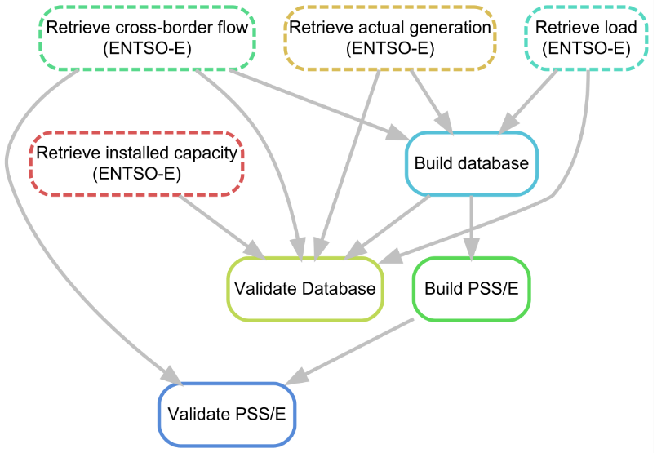
Nordic Transmission grid model
Input
PyPSA-Eur
ENTSO-E Transparency
Installed generation capacity
Generation (time series)
Load (time series)
Cross-border physical flows
Output
Database
PSS/E models
Validation reports

Slide 20
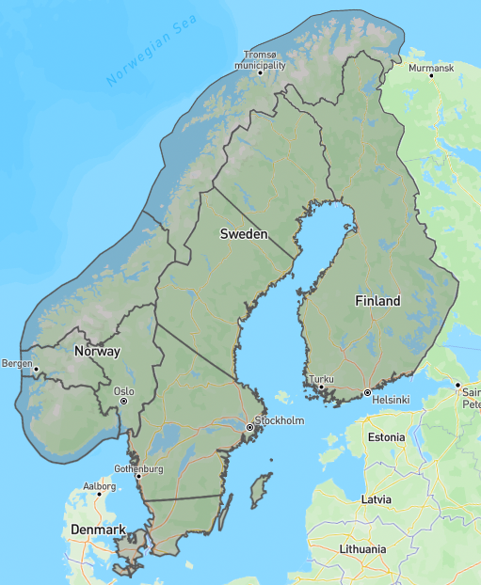
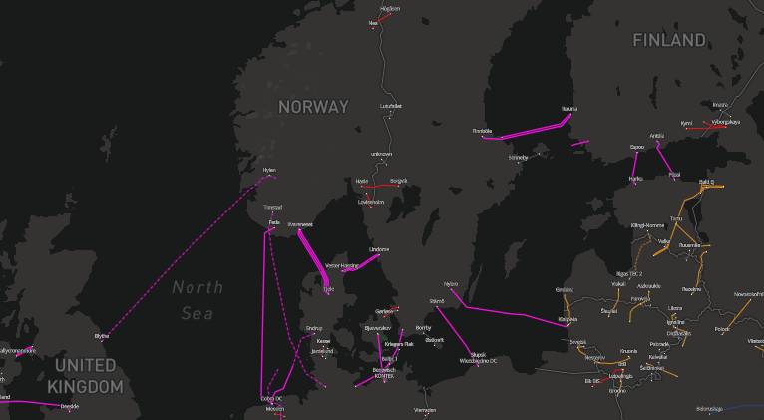
Nordic Transmission grid model – modifications
Bus
Bidding zone
Line
Impedance
Generation
Estimate actual generation
Scale per bidding zone
Load
Scale per bidding zone
Subtract losses
External Links
Distribute cross-border flows
380kV → 400 kV

Slide 21
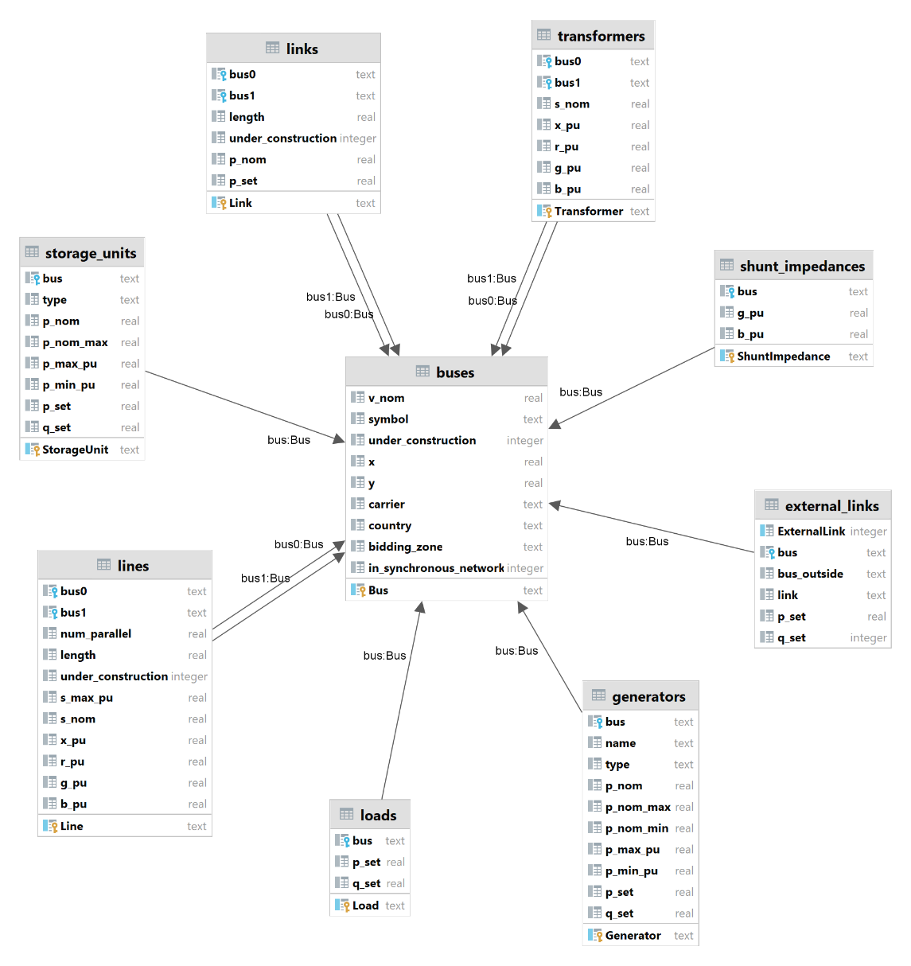
Database

Slide 22
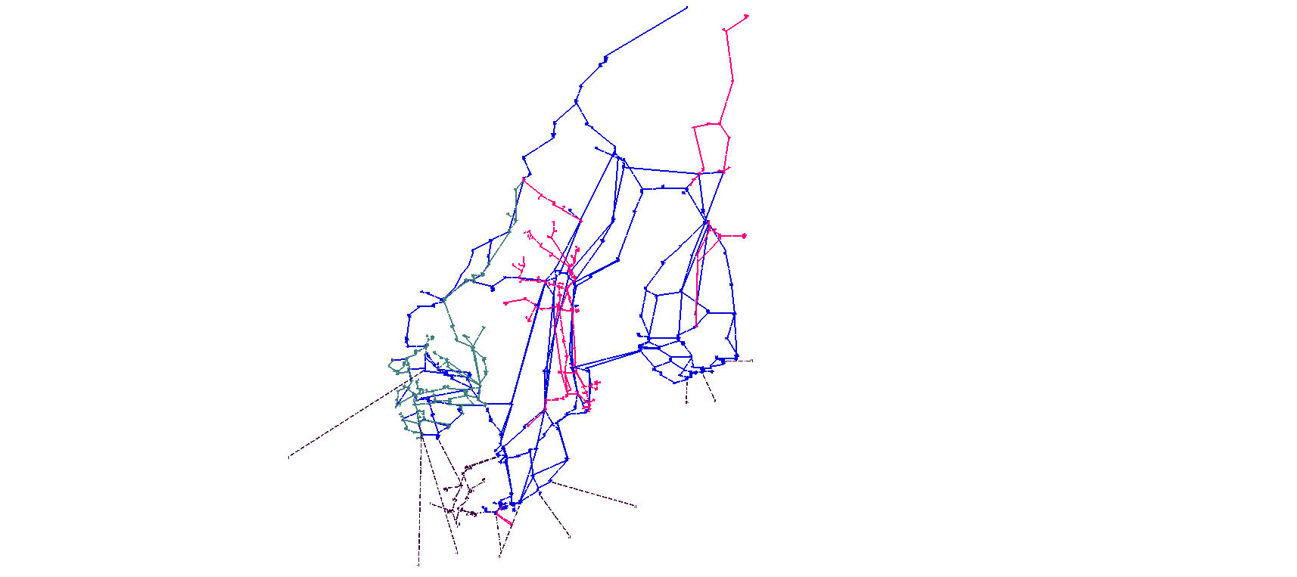
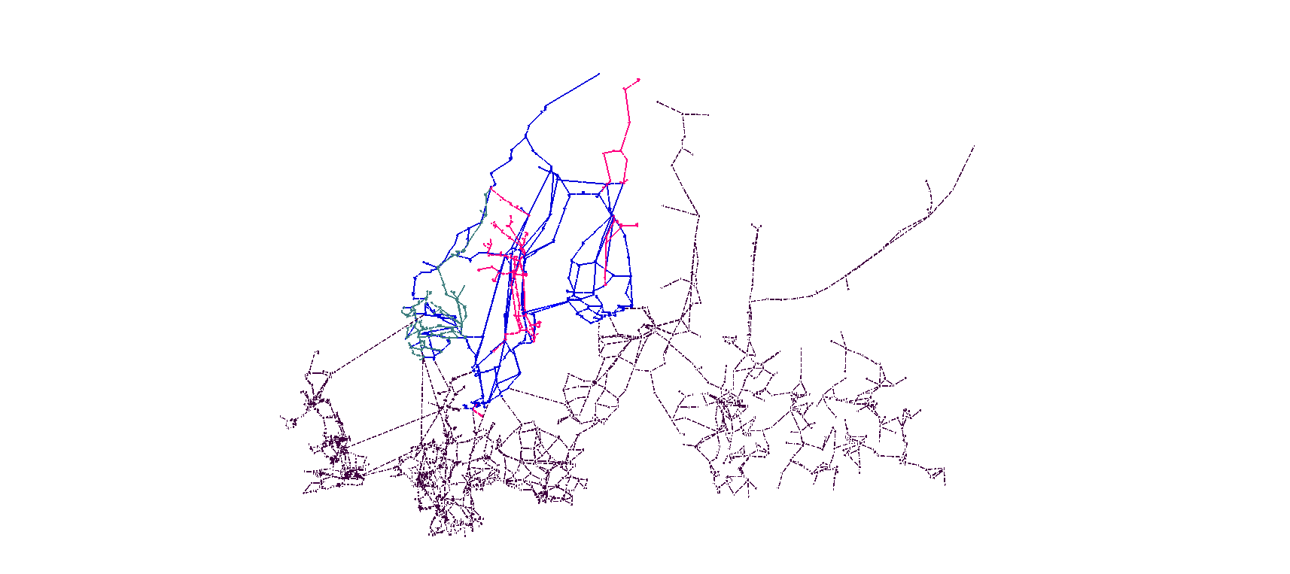
Model in PSS/E
Database | PSS/E
Bus | Bus
Load | Load
Generator | Plant / Machine
Storage Unit | Plant / Machine
Shunt Impedance | -
Line | Branch – AC Line
Transformer | Branch – 2 Winding
Link | Branch – VSC DC
External Link | Load

Slide 23
Overview
Introduction
Open-source models, tools and datasets
Model
Validation data
Load flow
Conclusion
Further work

Slide 24
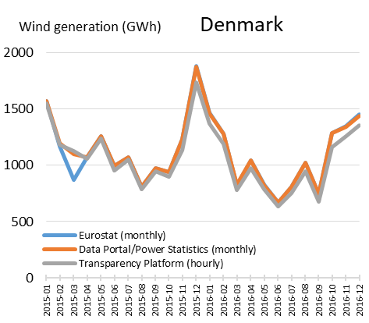
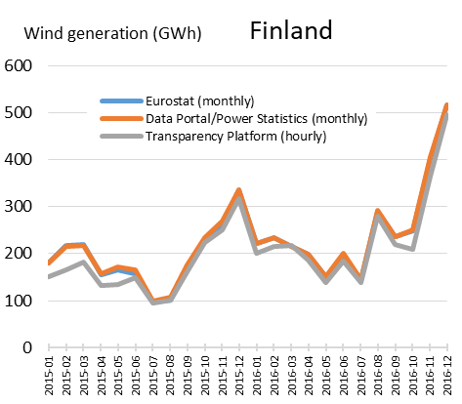
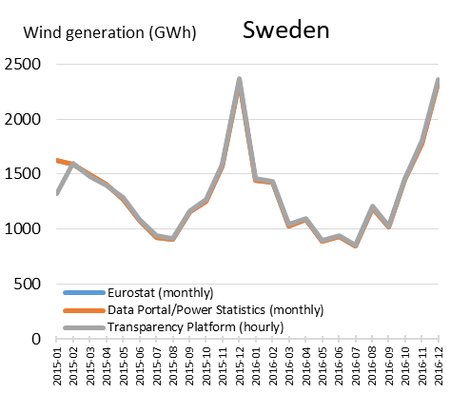
Validation of ENTSO-E Transparency Platform (wind)
Source: The ENTSO-E Transparency Platform – A review of Europe’s most ambitious electricity data platform
Notes:
Load is also validated, but only for small time ranges → much more accurate in newer data than 2015-2016

Slide 25
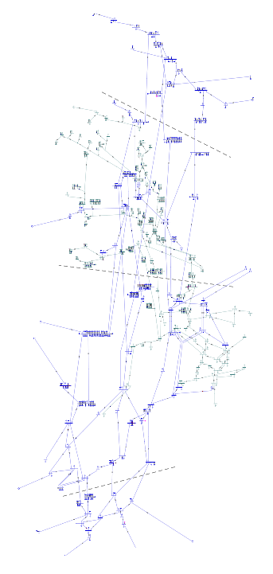
Comparison to DNV Swedish model (2017)
Generation [MW] | Model 2017 | Model 2023 | Difference | Difference [%]
SE1 | 3,142 | 4,470 | 1,327 | +42%
SE2 | 6,423 | 5,818 | -605 | -9%
SE3 | 10,361 | 9,092 | -1,269 | -12%
SE4 | 1,138 | 808 | -330 | -4%
Total | 21,064 | 20,188 | -877 | -4%
Load [MW] | Model 2017 | Model 2023 | Difference | Difference [%]
SE1 | 1,410 | 1,410 | 0 | 0%
SE2 | 2,395 | 2,395 | 0 | 0%
SE3 | 12,341 | 12,341 | 0 | 0%
SE4 | 3,542 | 3,542 | 0 | 0%
Total | 19,688 | 19,688 | 0 | 0%

Slide 26
Comparison to DNV Swedish model (2017)
 | Actual [MW] | Model [MW] | Difference [MW] | Difference [%]
SE1-SE2 | 314 | 1,326 | 1,012 | +322%
SE2-SE3 | 4,033 | 4,765 | 732 | +18%
SE3-SE4 | 3,420 | 3,720 | 300 | +9%

Slide 27
Overview
Introduction
Open-source models, tools and datasets
Model
Validation data
Load flow
Conclusion
Further work

Slide 28
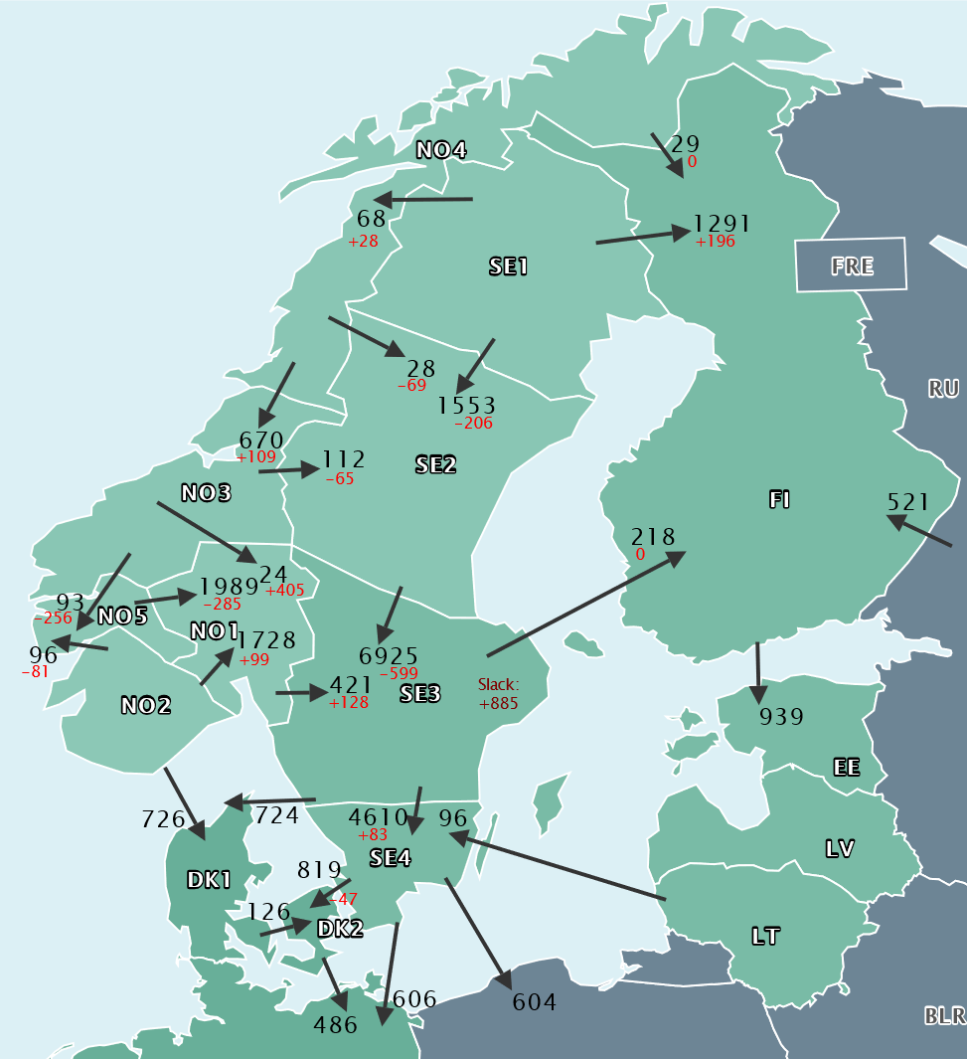
Load flow
2020 data
Black: ENTSO-E TP
Red: Difference model

Slide 29
Overview
Introduction
Open-source models, tools and datasets
Model
Validation data
Load flow
Conclusion
Further work

Slide 30

Conclusions
Model is reliable after analysis
Account for data inconsistencies
Open-source models
Never perfect
Hard to verify
Weaknesses lie in missing data
Reproducible
Updatable
Reliable
Extendable

Slide 31
Overview
Introduction
Open-source models, tools and datasets
Model
Validation data
Load flow
Conclusion
Further work

Slide 32
Further work
Missing information in Sweden
Add generation distribution per bidding zone
Validation
Find additional validation data
Extend to mainland Europe
Easy with project setup

Slide 33
Niek.Brekelmans@dnv.com

Slide 34
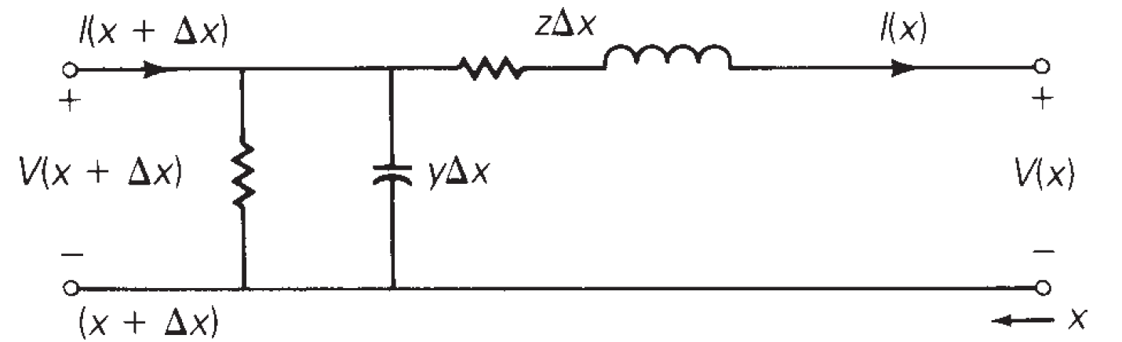
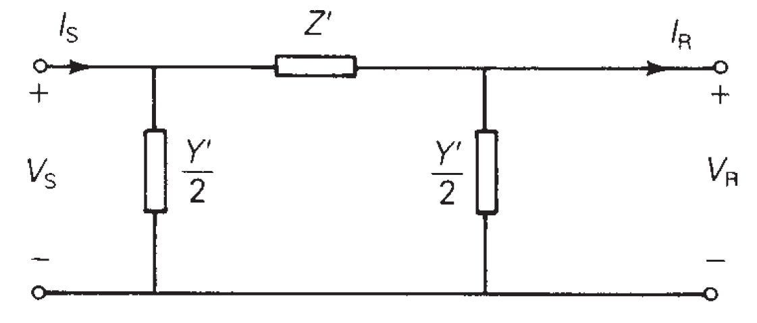
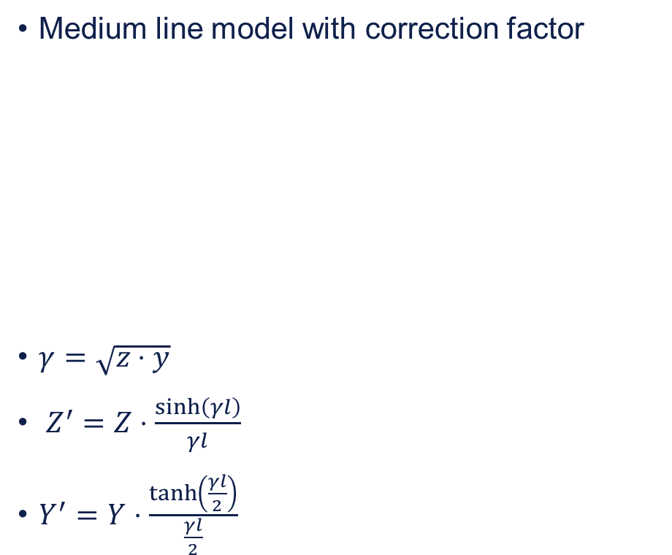
Line model
Long line model
Differential not possible in PSS/E
Medium line model with correction factor
$γ=\sqrt{z⋅y}$
$Z^{′}=Z⋅\frac{sinh\left(γl\right)}{γl}$
$Y^{′}=Y⋅\frac{\tanh\left(\frac{γl}{2}\right)}{\frac{γl}{2}}$

